Slide 1
“WHY DO WE NEED A DBA??”
Stephen McCord
Chief Data Officer (AH) / Vice President, Data Strategy (MA)
AdherisHealth

Slide 2

Agenda
Who?
Who Else?
Where?
How?
Why?

Slide 3

What’s a DBA?
A Database Administrator (DBA) is an IT professional that’s responsible for the Confidentiality, Integrity, and Availability of an organization’s data assets.
Using various learned techniques and tricks of the IT trade, we ensure that the right people are able to get the right stuff when they need it.

Slide 4
What’s a DBA? (cont.)
In today’s “*aaS” landscape, you’ll find no shortage of people trying to sell you on the idea that you can cut corners and save cost when it comes to comprehensive management of your enterprise database footprint.
Notes:
Time and time again, this has proven to be an oversimplification, and a frequently a literal interpretation of the word “Administrator”.
Generally speaking, a good DBA isn’t simply born that way. Rather, they’ve honed their skills through trial and error and have a good understanding of the fact that despite no two database environments being the same, they all share a ton of commonalities.
Recognizing that fact is a large part of what separates “a good DBA” from your standard “Admin.”

Slide 5
WHO ARE THE PLAYERS?

Slide 6
PRODUCTION DBA
Notes:
This is the DBA that is directly responsible for the most sensitive, critical aspects of an organization’s database environment

Slide 7
PRINCIPAL / LEAD DBA
Notes:
Here’s the DBA that’s generally responsible for every other discrete aspect of the Database Environment. He answers questions on behalf of the CDO, and backs up the Prod DBA.

Slide 8
DATA / DATABASE ENGINEER
Notes:
This is the person on the team that’s looking for opportunities to score, and putting the puck in the opposing net / coming up with solutions to make use of data as efficiently as possible

Slide 9
DATA SCIENTIST
Notes:
Keeping an eye on the puck as it moves around the ice, thinking ahead while it (the data) moves, researching, theorizing and drawing data driven conclusions.

Slide 10
DATABASE DEVELOPER
Notes:
Interacting with “customers” and developing solutions to serve their needs within the bounds of the rink.

Slide 11
IT SYSTEMS
Notes:
In addition to people in an organization with a “Data-Centric” purview, we have the folks that make sure everyone has what they need, be it a server to host a DBMS or a sharp pair of skates, a new stick or some more computing resources. Everyone wants to be friends with the Systems guys.

Slide 12
IT SECURITY
Notes:
Just like a referee, the folks in IT Security make sure everyone’s following the rules of play, and holding us accountable to the expectations we have collectively.

Slide 13
CHIEF DATA OFFICER
Notes:
The last line of defense, or “Goalie”. If all other efforts have been expended, this is the person that’s ultimately on the line to stop various threats and deliver on the promises of success.

Slide 14
CHIEF INFORMATION OFFICER
Notes:
At the top of the food chain, we have the Chief Information Officer. This is our Head Coach, the person who keeps us motivated, on point, on task and in the best position to succeed on behalf of the business.

Slide 15
TEAMWORK
Notes:
The Hockey Puck can be thought of as data. The puck can be viewed as a threat or an opportunity depending on what part of the ice it’s on. The same can be said for data.
As DBAs, our main goal is to keep the puck out of the net / make sure our data is comprehensively, meticulously managed
Our teammates on the ice out on the front line are actively trying to put the same puck in the opposing teams’ net.
The training and operations folks in the back are making sure our skates are sharp, our sticks are strong, the ice is nice and smooth and our helmets are buckled. Just like IT Systems making sure our computing network is humming along, and purring like a kitten.
The referees / IT Security are making sure we follow the rules, while protecting us against “the other team” breaking those same rules to cause us harm.
Finally, we have the Head Coach / CIO who makes it all work from stem to stern, and getting all the credit for our hard work along the way.

Slide 16
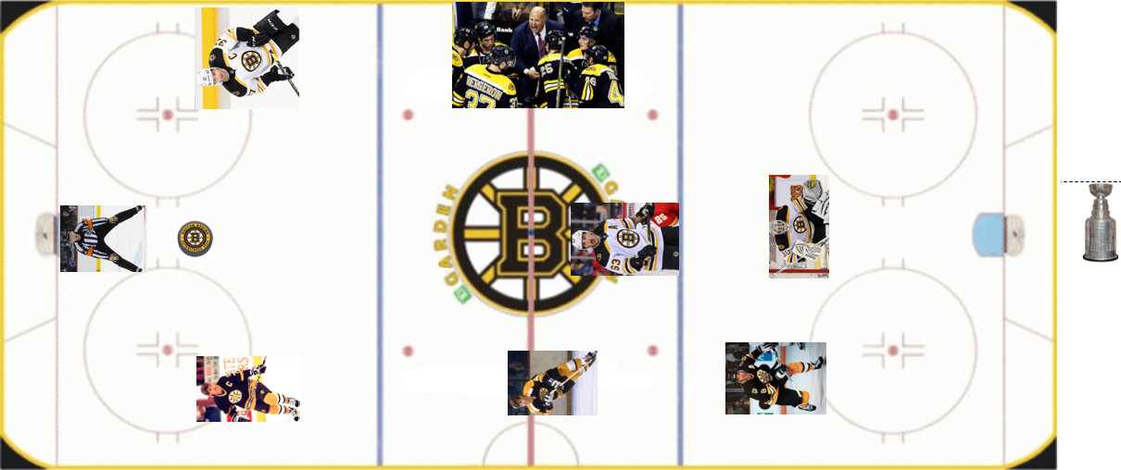
CHAOS
Notes:
Players out of position, sometimes deliberately.
Referees responsible for goals allowed.
Coach responsible for rule interpretation and enforcement.
Single point of defensive responsibility on one defenseman
Implied defensive responsibility placed upon center.
Other defenseman (resources) ambiguous due to demonstrated additional aptitudes
Left wing on right side.
Right wing blocked by goalie who is out of position

Slide 17
ORDER WITHIN CHAOS
Notes:
IT Infrastructure can be confusing to an outsider, and downright intimidating even to those of us that look at it comprehensively. Many will tell you that the data environment within that infrastructure is the most confusing of all. The overwhelming nature of a data environment, the nuances that are inherent to it, and the care required to manage it effectively are all considerations that should be made when determining the best players on your team. Do you want the flashy superstar that can net you 75 goals in a season (DBaaS) at an exorbitant cost? Do you want the Center (or worse, the refs) playing goal? Or do you want a well-oiled machine, with thoughtfully placed resources that can withstand the challenges of a long season (career)……..

Slide 18
WE’RE ALL SHOOTING FOR SOMETHING
Notes:
Whether it’s the Stanley Cup, or keeping the lights on, and the water running thus making IT seem invisible to the rest of an organization. It’s my experience that a well-defined team with the right players out on the ice makes the difference every time.

Slide 19

Team
John Ciccio
President & CEO
Joel Gerber
VP Product IT (CTO)
Steve McCord VP Data Strategy (CDO)
Tim Thomas
2011 Stanley Cup Champion

Slide 20




Thank you!
steve.mccord@adherishealth.com
www.adherishealth.com

